Slide 1

Accurate PREDICTION of BOUNDING BOXES in OBJECT DETECTION
Bounding Box Regression with Uncertainty for Accurate Object Detection (He et al.)
SOURADIP PAL

Slide 2
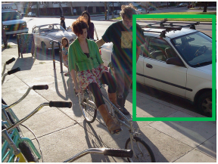
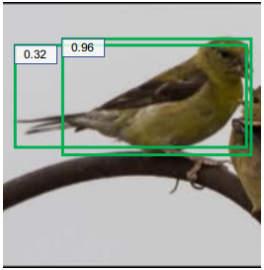
Introduction
Current challenges in Object Localization
Various ambiguities in ground-truth bounding box locations
Incorrect labelling in large-scale object detection datasets e.g., MS-COCO
Objects might be occluded, and object boundaries might not be visible
Most object detectors use Smooth-L1 Loss which is not always suitable for bounding box regression
High classification score does not always mean accurate bounding box regression
Localization uncertainties not captured by the object detection model
Image: Credit to He et al.

Slide 3
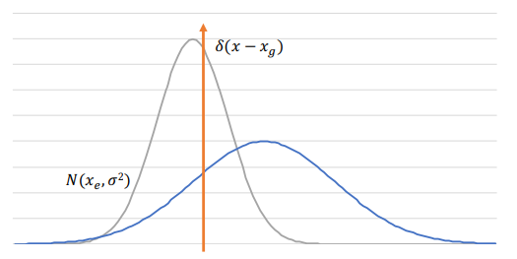
Problem Statement
Use KL-Loss for Bounding Box Regression based on the paper “Bounding Box Regression with Uncertainty for Accurate Object Detection” (He et al.)
Predicted bounding box coordinates modelled as Gaussian distribution
Ground-truth bounding box coordinates modelled as Dirac-delta functions
Use predicted localization variance in computing box regression loss
Select better box detections using “Variance-Voting” like Soft-NMS(Non- Maximum Suppression)
Image: Credit to He et al.

Slide 4
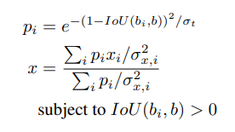
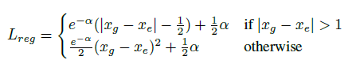
Algorithms
KL-Loss
Variance Voting
Calculate the KL Divergence between the Gaussian and Delta distributions
If variance is 1, KL-Loss is similar to Smooth-L1 Loss
KL-Loss depends on α = log(σ²) where σ² is the variance. Network predicts α.
Assign weights to neighboring detections to improve location
Larger IoU and lower localization variance gets higher voting score
Does not depend on classification score as higher classification score does not necessarily mean higher localization confidence
Can be done along with soft-NMS
Image: Credit to He et al.

Slide 5
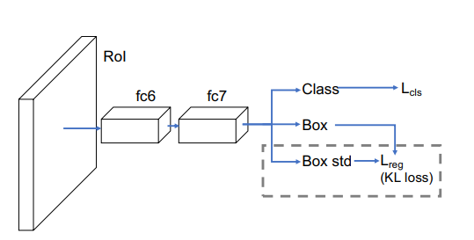
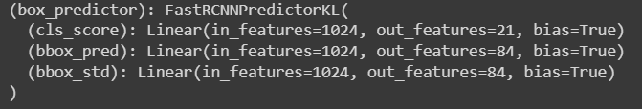
Implementation
KL-Loss and Var-Voting implemented in Pytorch. Original implementation in Caffe2 using Detectron.
Used Faster-RCNN Resnet-50-FPN backbone model pretrained on MS-COCO dataset with 90 classes
Modified architecture to predict box localization variance
Incorporated KL-Loss and Var-Voting algorithms
Trained and validated on PASCAL-VOC(2007) data with 20 classes
Compared with the existing implementation based on mAP(mean average precision)
Image: Credit to He et al.

Slide 6
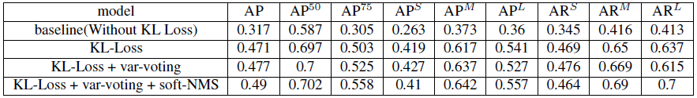
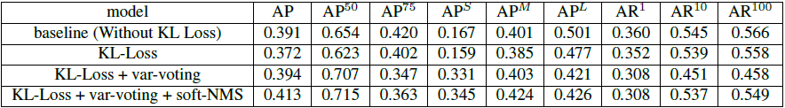
Results
Experiments done with existing & custom implementation
Experimented with MMDetection implementation using small sample of MS-COCO data
Experimented with custom implementation using PASCAL-VOC dataset(5K images)
Conducted ablation experiments by switching on/off var-voting and soft-NMS
Results close to original paper though lower than expected
Did not perform well in detecting smaller objects. Low AP^{S} value.
Existing results
Reproduced results

Slide 7
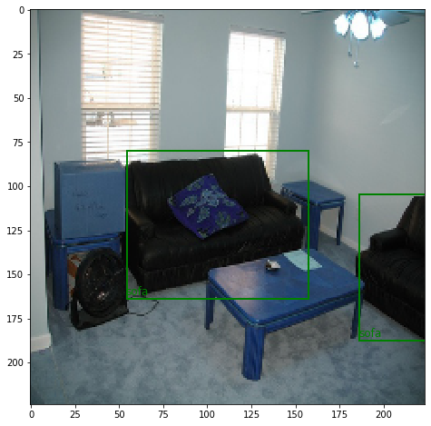
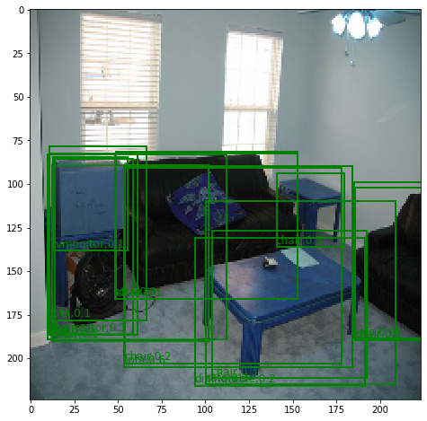
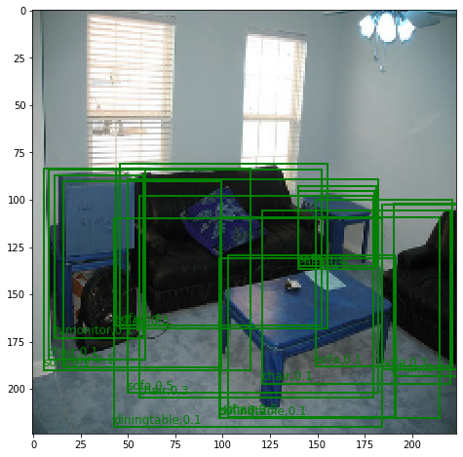
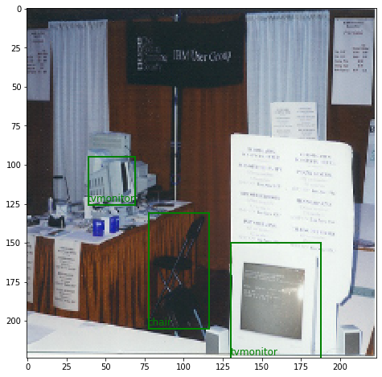
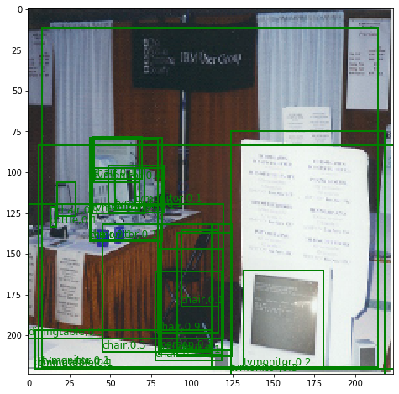
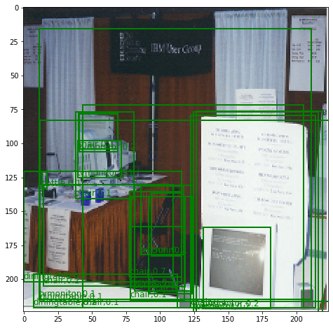
Number of ground truth boxes = 2
Without KL Loss. Number of candidate detections = 16
With KL Loss. Number of candidate detections = 18
Number of ground truth boxes = 3
Without KL Loss. Number of candidate detections = 22
With KL Loss. Number of candidate detections = 23

Slide 8
Future Work
Improvements on top of the current work
Can be tested using other backbone models like VGG-16
Larger datasets like MS-COCO (118K training images) can be used
Can be trained using more GPU resources and more epochs
Can be included into Detectron2 framework via configuration
Better probabilistic approaches to model localization uncertainties

Slide 9
Thank You
References
https://openaccess.thecvf.com/content_CVPR_2019/papers/He_Bounding_Box_Regression_With_Uncertainty_for_Accurate_Object_Detection_CVPR_2019_paper.pdf
https://pytorch.org/tutorials/intermediate/torchvision_tutorial.html
http://host.robots.ox.ac.uk/pascal/VOC/
https://cocodataset.org/#home
https://github.com/chongruo/tiny-coco
https://github.com/facebookresearch/detectron2
https://github.com/yihui-he/KL-Loss
https://github.com/yihui-he/Stronger-yolo-pytorch
https://github.com/cxliu0/KL-Loss-pytorch

